Slide 1
College and Pub Distribution in Bratislava and Wien
(Comparative Study)
Annamária Zagyi Takáts
4/30/2021

Slide 2
Introduction and Background
Bratislava (Slovakia) and Wien (Austria) are the two nearest capital cities in Europe, distancing from each other just around 70 kms. Both of them are university cities with lot of colleges and of course pubs and bars are very often crowded especially in college surroundings.
The aim of this project is to explore the correlation and distances between these two objects and compare them based on city levels.
The objective of this project is to analyze and select the best location (in terms of city choice and average distances to the college) to open a pub.
Additional question “How far should I go to the nearest pub from my college if I am a student”.

Slide 3
Data
All data related to locations of venues are obtained via the FourSquare API utilized via the Request library in Python.
We use Geopy library to receive location data for particular areas.
Geolocator from Python Geocoder package is used to gain geographical coordinates of Wien and Bratislava. This is required to plot the map and get the venue data.
Data sets containing 32 university venues and 100 pub venues in Bratislava
Data sets containing 68 university venues and 73 pub venues in Wien.
We apply Folium maps for visualizing the venues coordinates.
Geodesic and Math libraries are used for calculations and the data is be visually assigned using graphing from Python libraries.
Data results are plotted in Bar and Box plots to visualize statistical summaries of the obtained results.

Slide 4
Methodology
Geolocator output:
The geographical coordinate of Bratislava are 48.1516988, 17.1093063.
The geographical coordinate of Wien are 48.2083537, 16.3725042
Foursquare query for University venues in 10 000 meters radius of Bratislava and result limit set to 100. Second Foursquare query for Pub venues in 10 000 meters radius of Bratislava with the result limit set to 100.
We repeat the same Foursquare queries for Wien with radius of 2 000.
The obtained Json files are normalized, cleansed and structured into Pandas Dataframes
Final dataset for Bratislava is created by combining the Pubs and Colleges datasets and calculating all possible distances via Geodesic and grouping by Universities.
Result sets (for Bratislava and Wien separately):
Universities with corresponding shortest distance to a Pub
Universities with corresponding longest distance to a Pub
Universities with corresponding mean distance to a Pub

Slide 5
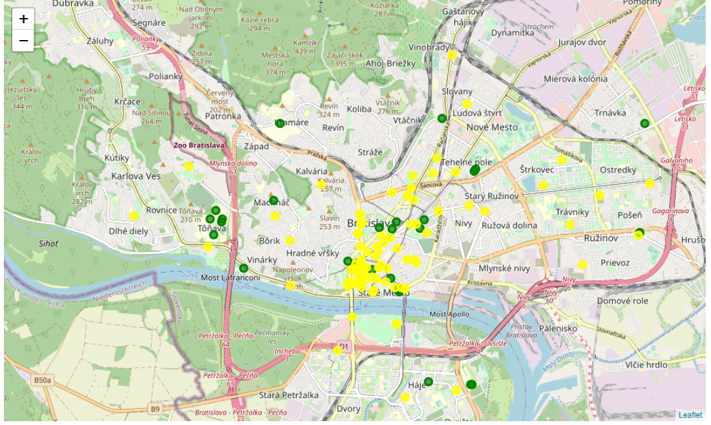
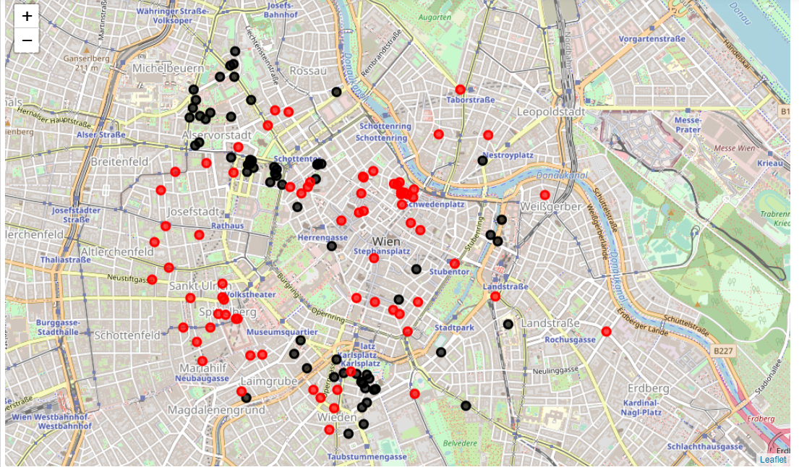
Universities and Pubs in Bratislava and Wien

Slide 6
Results
In Bratislava we have 100 pubs serving 32 universities while in Wien the same ratio is just 73/68. It means a better opportunity for investing into pub or bar opening in Wien than in Bratislava.
In Bratislava there are longer distances between the studied entities than in Wien.
It is highly recommended to choose the place for the new pub ulterior to college areas as the near surroundings are already taken up by existing Bars and Pubs.
Despite the fact that in Bratislava there is a higher percentage of Pub and Bar occurrence in a given College neighborhood, their accessibility in terms of distances has lower range.

Slide 7
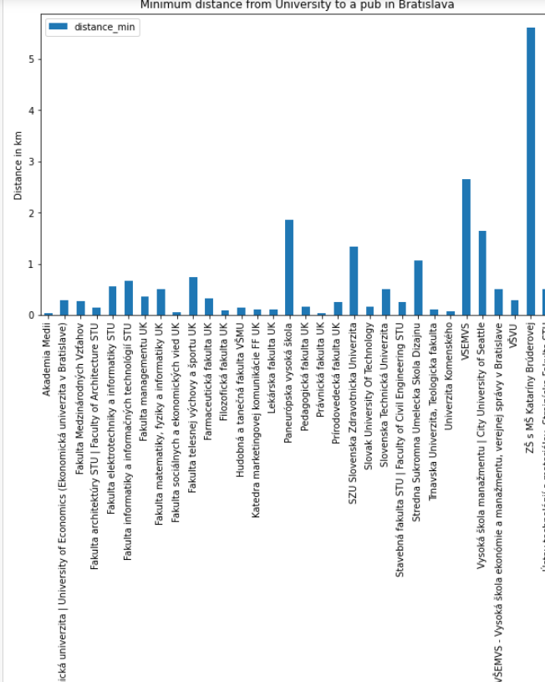
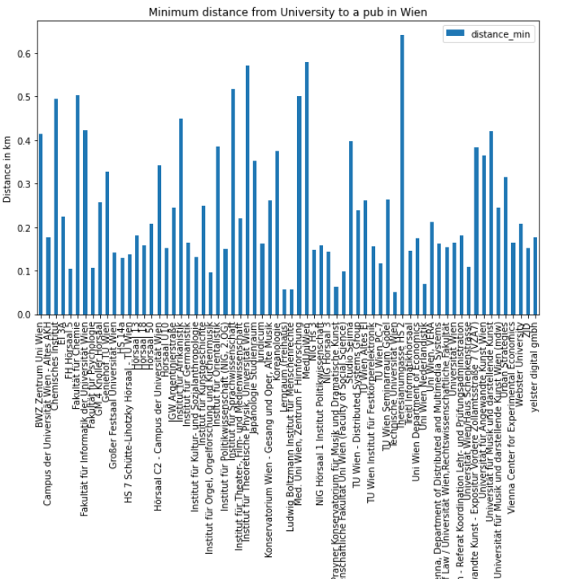
Minimum distance form University to a Pub

Slide 8
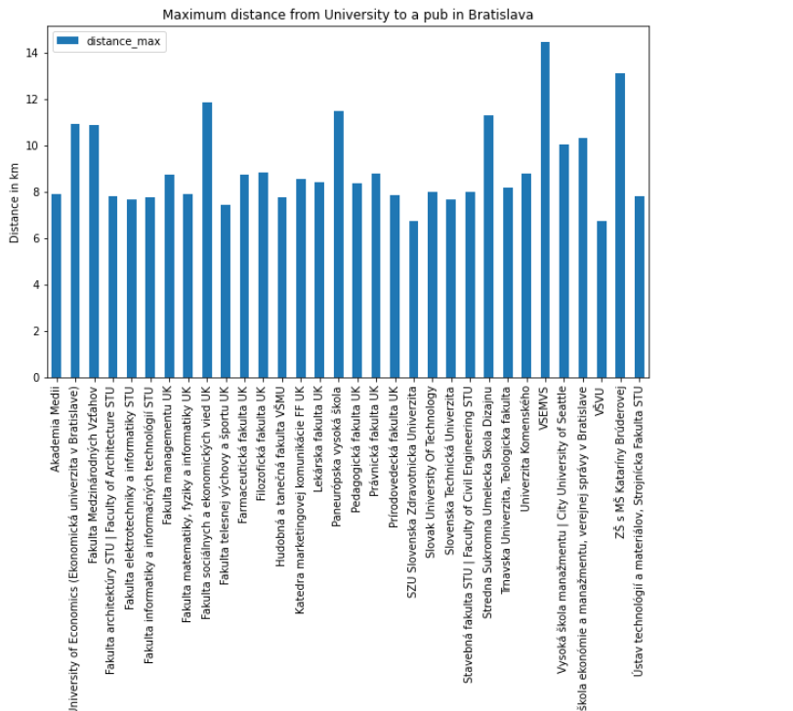
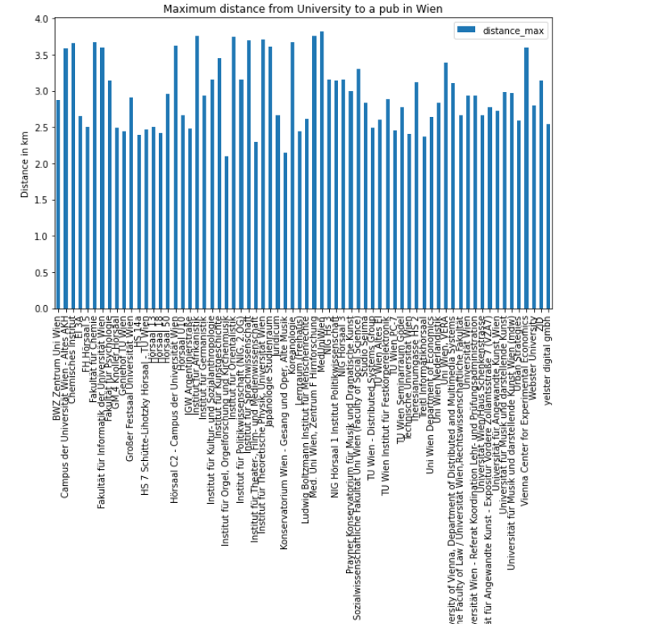
Maximum distance form University to a Pub

Slide 9
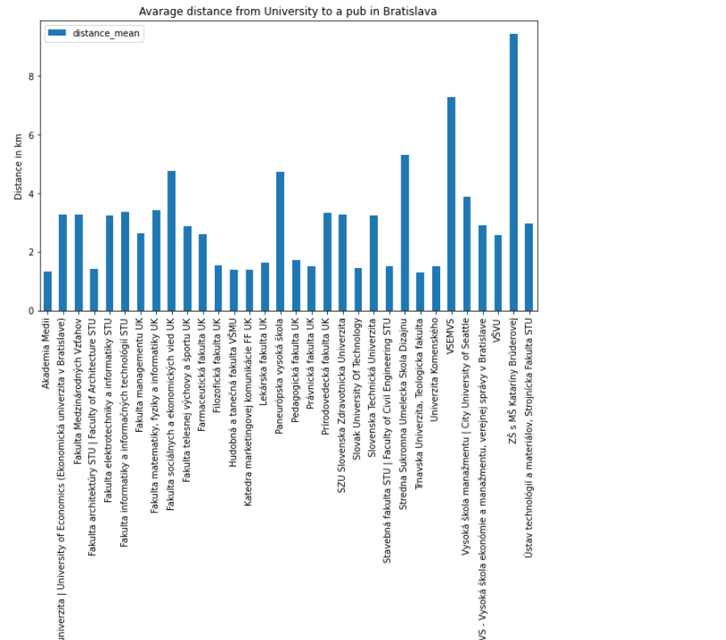
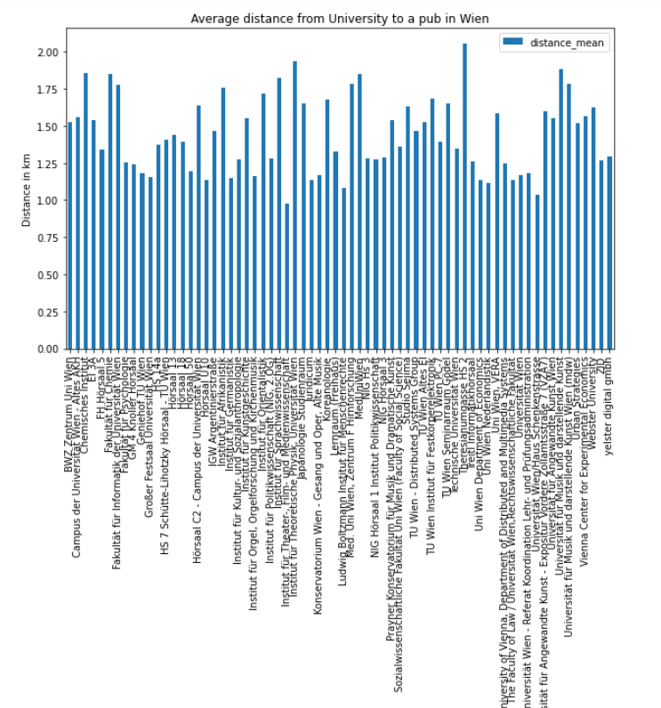
Average distance form University to a Pub

Slide 10
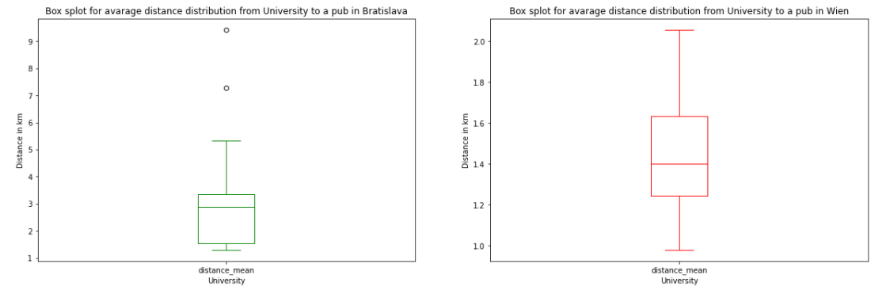
The statistical mean distance distributions

Slide 11
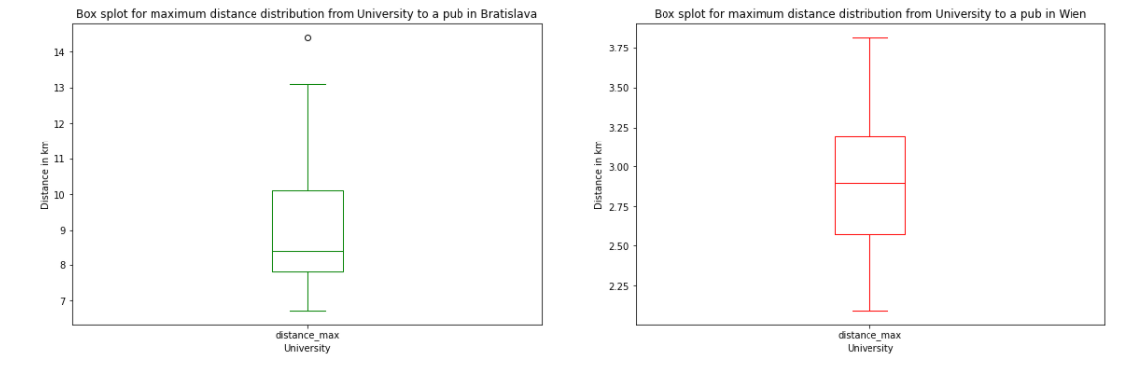
The statistical maximum distance distributions

Slide 12
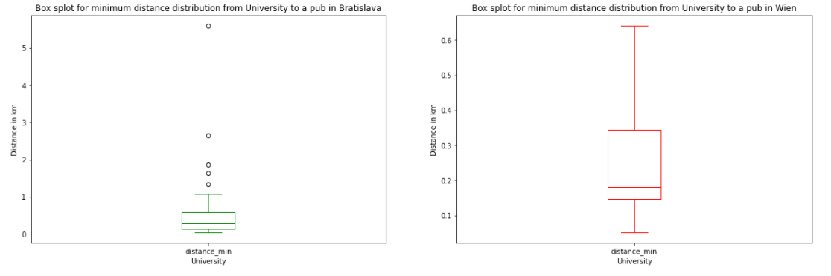
The statistical minimum distance distributions

Slide 13
Discussion and Conclusion
Selection criteria for venues in the two cities differ in the range of examined radius.
Leading to biases when determining the results of distances between recognized Colleges and Pubs.
Geographical parameters of Wien and Bratislava
Proving results for opening a new bar or pub rather in Wien than in Bratislava.
As the shortest distances are smaller in Wien, the recommendation would be to open new bars and pubs outside the college areas.
For students: results sets of the attached Jupyter notebook containing the shortest way from each university in the sample data.

